Slide 1


Prototype Submission Phase

Slide 2
Code Cosmonauts
Sankalp Yadav (leader) Prithwika Das Sanjana Shenoy Lavanya Upadhyaya Rushabh Choudhary
THEME:
Enhancing Flight Navigation Mechanism for Optimal Route Planning and Risk Mitigation

Slide 3
PROBLEM STATEMENT
In the aviation industry, efficiently planning flight routes between airports is crucial for minimizing operational costs and optimizing travel times. Airlines and logistics companies need a reliable method to determine the shortest and most efficient paths between various destinations. However, given the vast network of potential routes and the variability in distances, manually calculating the shortest path is impractical and error-prone. Existing systems may not provide the necessary real-time computations or may require costly and complex infrastructure to deliver accurate route planning.

Slide 4
SOLUTION
Automated Route Optimization: We are developing a software solution that leverages existing algorithms to identify optimal flight paths, considering challenges like unavailable GPS signals, adverse weather, electronic failures, and varying pressures.
Real-Time Risk Assessment: Our solution integrates real-time data analysis to assess and mitigate risks, providing alternative routes for safe navigation to pilots, airlines, and airport authorities.
Comprehensive Data Collection and Management: We continuously gather data from various open sources or create sample datasets, encompassing factors affecting flight navigation such as weather conditions, environmental variables, and electronic system status. We use structured databases and expose data via APIs.
Scenario Identification and Documentation**: Our team identifies and documents various flight navigation scenarios based on the collected data, highlighting potential risks and challenges such as weather conditions, visibility issues, and system failures.
User Interface and Dashboard: We create a user-friendly interface displaying optimal flight routes along with associated risks

Slide 5
SOLUTION
Future Prospects To Take Under Consideration:
Integrate Real-Time Environmental Data:Integrate real-time environmental data, including weather conditions (storms, turbulence), visibility issues (fog, smoke, precipitation), altitude changes, varying pressures, and other environmental variables from sources like AviationWeather.gov API, OpenWeatherMap API, NOAA National Weather Service, NASA EOSDIS API, and ADS-B Exchange, to adjust route weights and ensure optimal flight performance and passenger comfort.
Electronic Failures: Utilize real-time aircraft sensor data to detect and weigh potential electronic failures, ensuring routes with higher risks of electronic interference or malfunctions are less prioritized.
Fuel Efficiency: Integrate fuel consumption models using historical flight data from sources like Kaggle Flights to prioritize routes that optimize fuel usage, promoting cost savings and environmental sustainability.
Emergency Landing Options: Include proximity to emergency landing sites in route planning, adjusting weights to favor paths with accessible emergency options, enhancing overall safety.

Slide 6
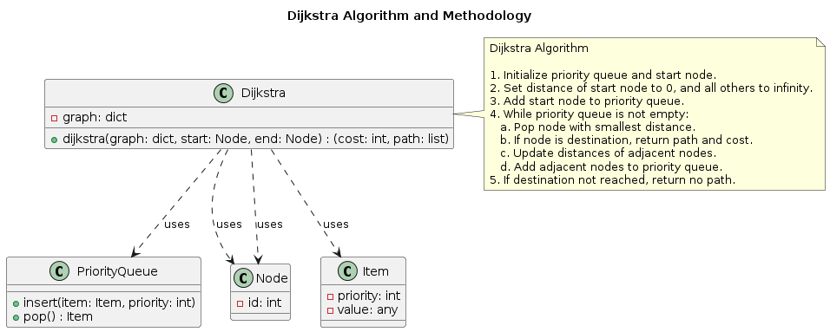
METHODOLOGY
Dijkstra's Algorithm Implementation for Flight Route Optimization

Slide 7
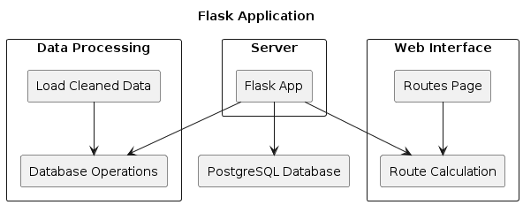
METHODOLOGY
Outline for the Flask Application

Slide 8
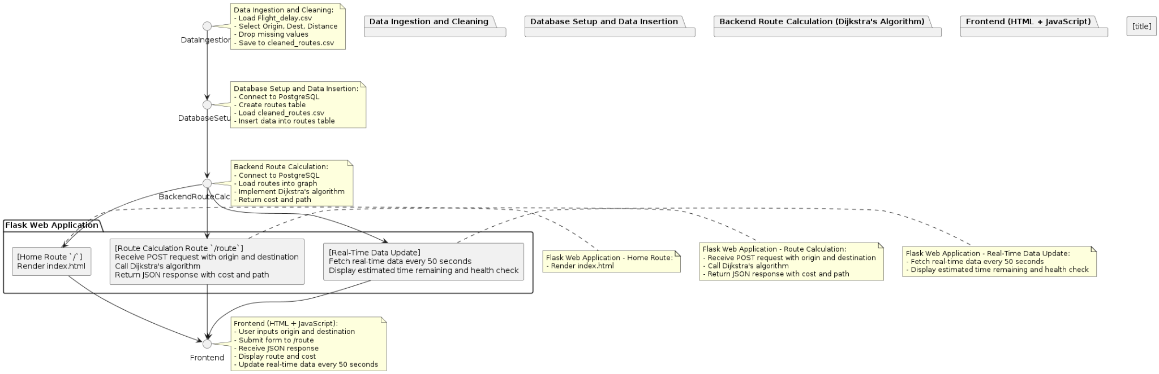
METHODOLOGY
Architecture Diagram

Slide 9
WORKING PROTOTYPE
PFA:https://github.com/PrithwikaDas/Flightroutes

Slide 10
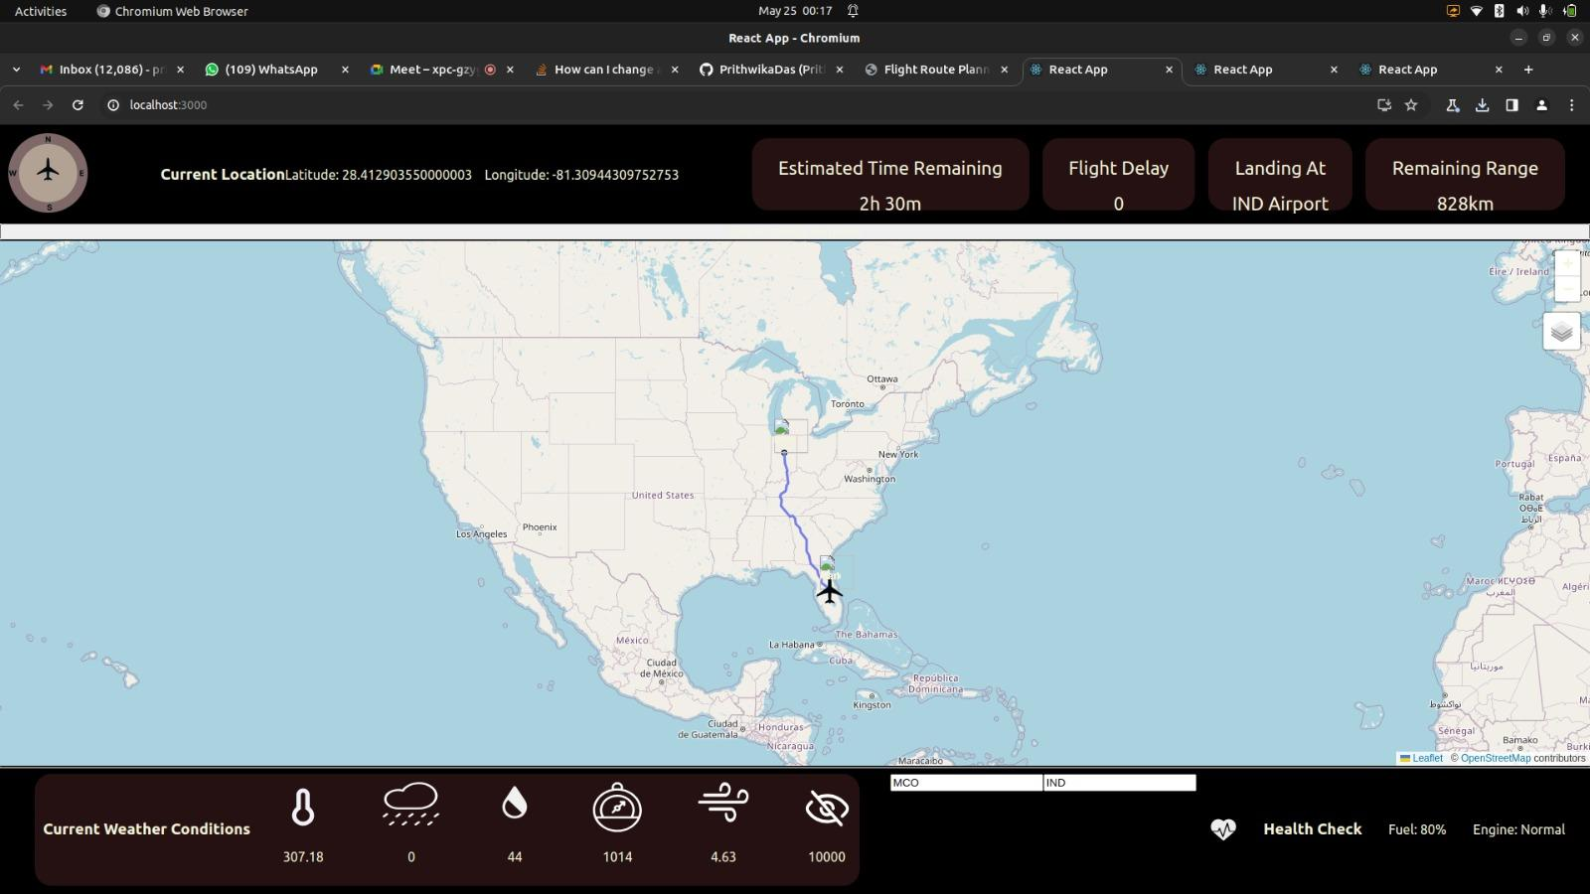
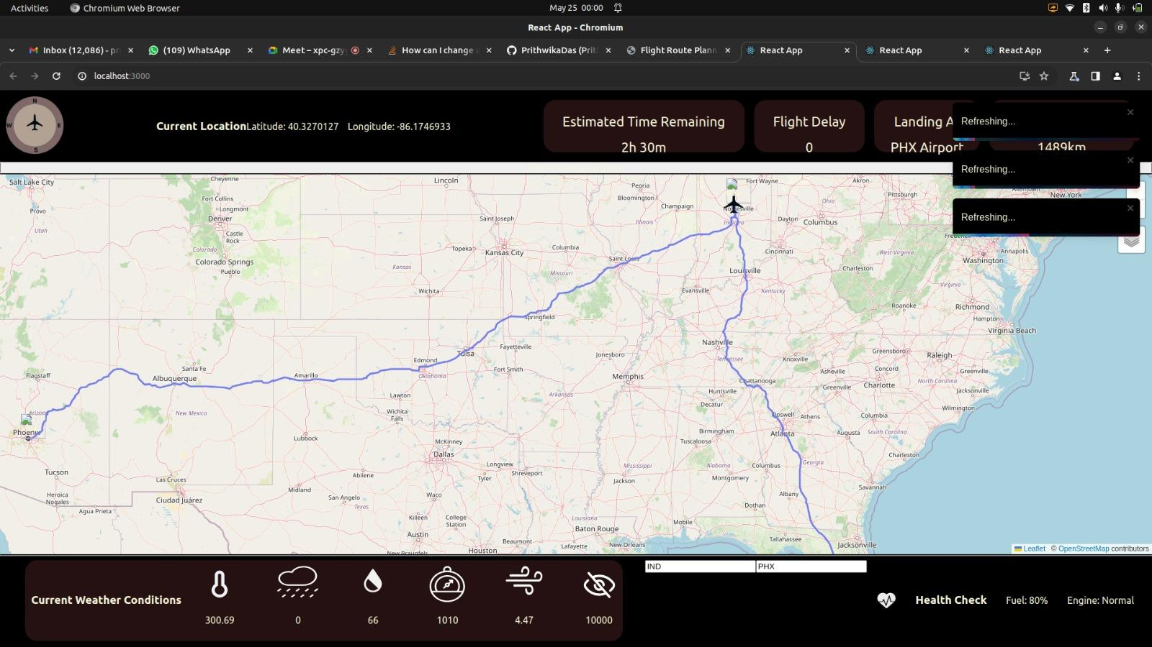
Attachments

Slide 11
Thanks And Regards Team Code Cosmonauts

